Slide 1
Relay Instructions
© 2014 John Sefcovic.

Slide 2
Relay Instructions
Relay ladder logic is a SYMBOLIC LANGUAGE constructed as a ladder diagram.
The elements of the ladder rungs are representations of NORMALLY OPEN or CLOSED RELAY CONTACTS as inputs, and outputs as COILS.
The establishing of a complete left to right PATH of TRUE input conditions, will cause a TRUE output action to occur.

Slide 3
Relay Instructions
A PLC program consists of rungs of logic that reads input conditions to cause output actions.
Each rung of logic is comprised of conditional inputs that are Examined for a TRUE condition.
If a true rung exists, then a TRUE output action occurs.
ACTION
CONDITIONAL INPUTS
OUTPUTS
The continuity of the Conditional Inputs will determine the Action Output.

Slide 4
Relay Instructions
Siemens S7
PROGRAM INPUT INSTRUCTIONS
-] [- NORMALLY OPEN CONTACT
-] / [- NORMALLY CLOSED CONTACT
The instruction symbol in the Ladder Logic Program reflects the status, OPEN or CLOSED, of the Input Field Device.
A program interprets the status of an address referenced to an instruction for a true condition.
PROGRAM OUTPUT INSTRUCTIONS
-( )- ASSIGNMENT

Slide 5
Relay Instructions
SIEMENS S7 TERMINALOGY
Operand signal state
-] [-
Operand output continuity
Instruction
The “Operand signal sate” is the current logic condition, data, used by the instruction.
An “Instruction” will determine how the signal state data will be altered for the conditional continuity.
The “Operand output” is the result of the instructions interpretation of the signal data for conditional continuity.

Slide 6
Relay Instructions
ASSIGNMENT
SIEMENS S7
OPERAND TYPE BYTE.BIT
TAG
-( )-
The “Assignment” instruction to set the bit of a specified operand. If the result of logic operation (RLO) at the input of the coil has signal state "1", the specified operand is set to state "1".
If the signal state is "0" at the input of the coil, the specified operand is reset to "0".

Slide 7
Relay Instructions
NORMALLY OPEN CONTACT
SIEMENS S7
OPERAND TYPE BYTE.BIT
TAG
-] [-
The activation of the normally open contact depends on the signal state of the associated operand. When the operand has signal state "1", the normally open contact closes and the signal state at the output is set to the signal state of the input.
When the operand has signal state "0", the normally open contact is not activated and the signal state at the output of the instruction is reset to "0".

Slide 8
Relay Instructions
NORMALLY OPEN CONTACT
SIEMENS S7
OPERAND TYPE BYTE.BIT
TAG
-] / [-
The activation of the normally closed contact depends on the signal state of the associated operand. When the operand has signal state "1", the normally closed contact opens and the signal state at the output of the instruction is reset to "0".
When the operand has signal state "0", the normally closed contact is not enabled, and the signal state at the output of the instruction is set to “1".

Slide 9
Relay Instructions
NO - NC STATEMENTS
For these instruction statements to be TRUE, operand output continuity of “1”:
NO, when signal state is…
-] [- = VOLTAGE = ON = LOGIC '1' = SET
NC, when signal state is…
-] \ [- = NO VOLTAGE = OFF = LOGIC '0' = RESET

Slide 10

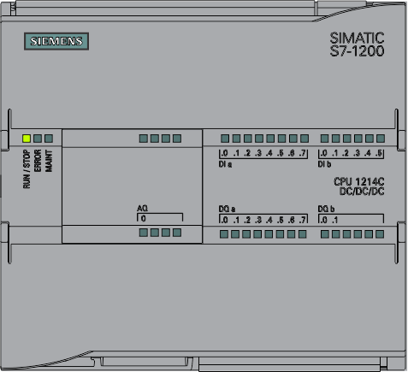
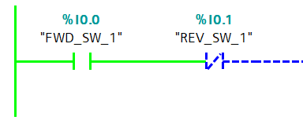
Relay Instructions
The instruction type identifies the state of the Field Input wired to the module for a TRUE condition for that instruction type.
When the switch is in a MADE condition, the Normally Open is TRUE.

Slide 11

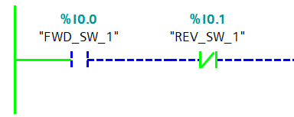
Relay Instructions
The instruction type identifies the state of the Field Input wired to the module for a TRUE condition for that instruction type.
When the switch is in a BREAK condition, the Normally Closed is TRUE.

Slide 12
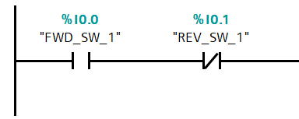


Relay Instructions
The Siemens Ladder Logic Instruction and the Electrical Symbol both use the same terminology, Normally Opened and Normally Closed.
Ladder Logic Instruction
Normally
Opened
Normally
Closed
Electrical Symbol

Slide 13


Relay Instructions
The properly interrupt the Siemens Ladder Logic Instruction always associate the instructions with the Electrical Symbol of a Normally Opened Contact and Normally Closed Contact.
Ladder Logic Instruction
Normally
Opened
Normally
Closed
Electrical Symbol

